Slide 1
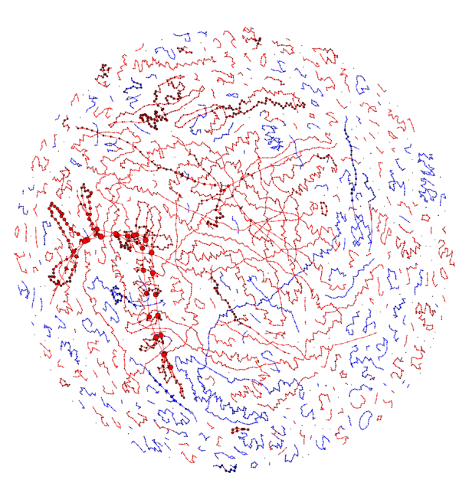
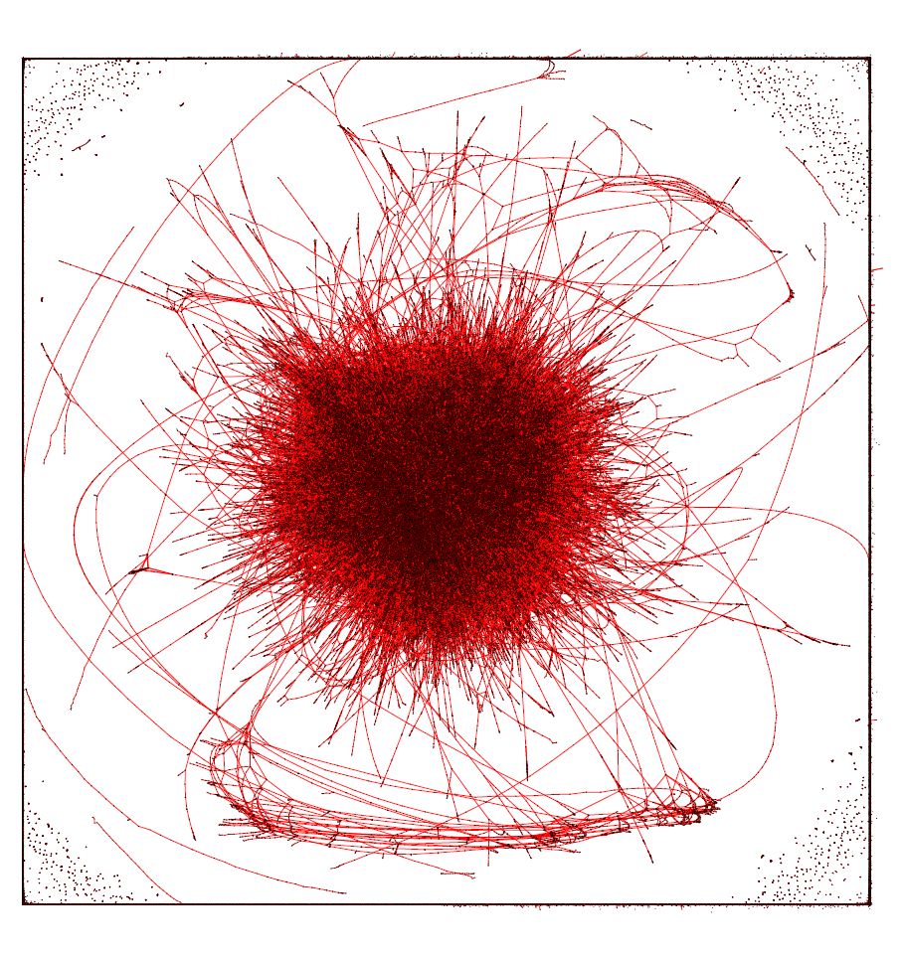
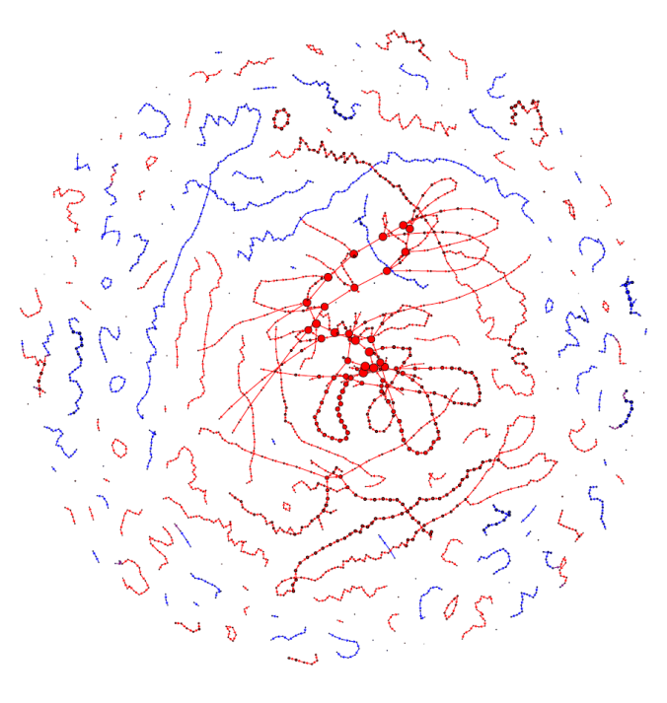
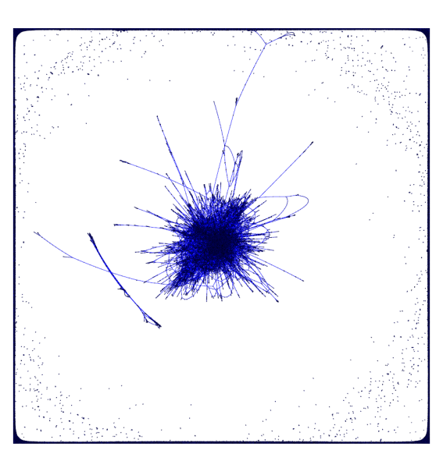
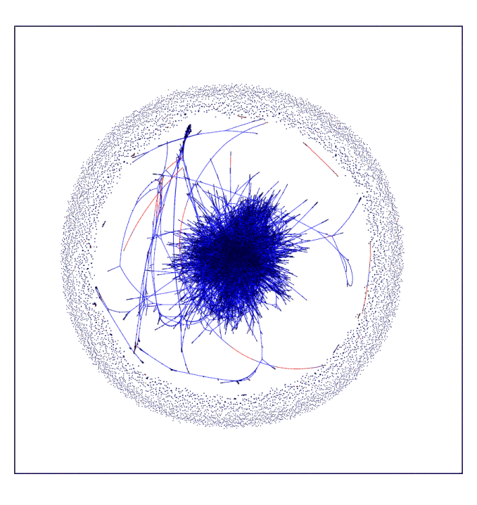
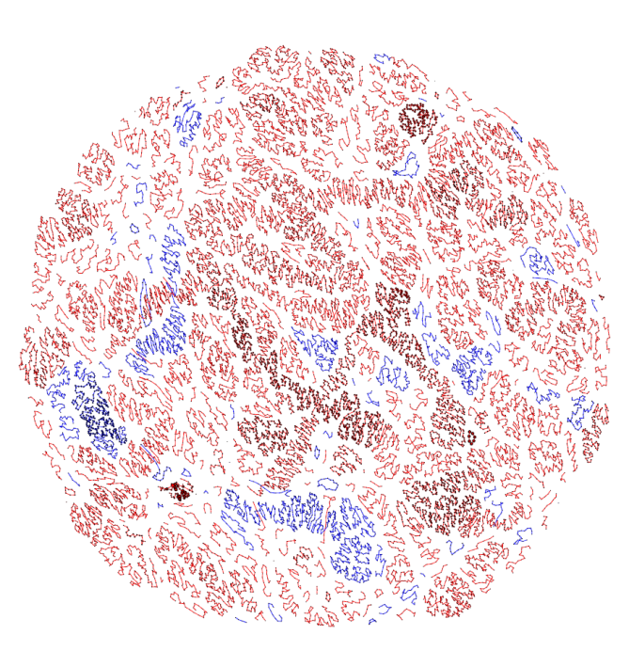
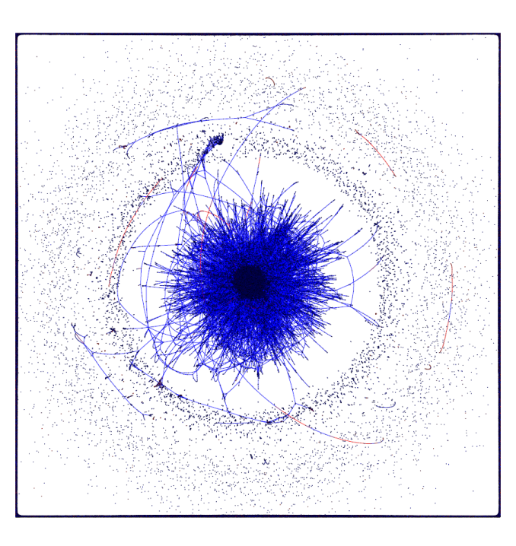
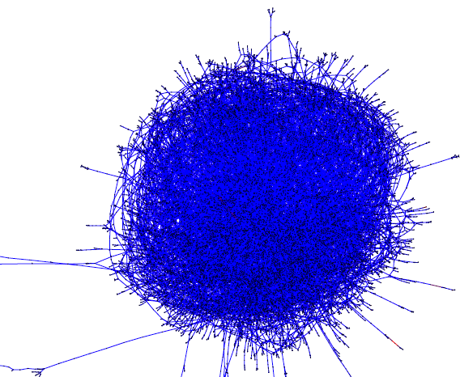
Communication: how to do it
Feedback: how to give it and receive it
BGEN 541

Slide 2
Communication and Feedback
Communication
Written
Today
Oral
Presentations
Feedback
How to receive it
Today
How to give it

Slide 3
Communication and Feedback
Communication
Written
Oral
Presentations
Feedback
How to receive it
How to give it

Slide 4
Written communication
Consider your audience
Determines level of detail and assumptions to be made
Examples:
CS audience
This work describes the Biomedical Data Translator program that seeks to couple machine learning and knowledge representation techniques to the myriad of biological databases to create an interactive reasoning tool. This reasoning tool will be used by biologists and clinicians via natural language queries and utilizes a variety of graph databases algorithms to answer user queries. The goal is to accelerate knowledge discovery and catalyze the next generation of biomedical translation for the understanding and treatment of disease.
Biomed audience
Myriad biomedical data are available today and bring with them a need to ‘translate’ those data into meaningful information that can be used to accelerate clinical and translational science and drive innovations in clinical care and drug discovery. We describe the work of The Biomedical Data Translator Consortium to develop a platform that supports the translation of data into knowledge by applying statistical and computer science techniques to representations of biomedical concepts and their relationships.
General audience
In this paper, we present the vision of the Translator project. The goal of the project is essentially to build a biomedical “ChatGPT": an automated platform for answering biomedical research questions that use many sources of publicly available information. The goal is to accelerate how quickly researches turn their ideas into actual treatments.

Slide 5
Written communication
Consider your audience
Determines level of detail and assumptions to be made
Examples:
CS audience
This work describes the Biomedical Data Translator program that seeks to couple machine learning and knowledge representation techniques to the myriad of biological databases to create an interactive reasoning tool. This reasoning tool will be used by biologists and clinicians via natural language queries and utilizes a variety of graph databases algorithms to answer user queries. The goal is to accelerate knowledge discovery and catalyze the next generation of biomedical translation for the understanding and treatment of disease.
Biomed audience
Myriad biomedical data are available today and bring with them a need to ‘translate’ those data into meaningful information that can be used to accelerate clinical and translational science and drive innovations in clinical care and drug discovery. We describe the work of The Biomedical Data Translator Consortium to develop a platform that supports the translation of data into knowledge by applying statistical and computer science techniques to representations of biomedical concepts and their relationships.
General audience
In this paper, we present the vision of the Translator project. The goal of the project is essentially to build a biomedical “ChatGPT": an automated platform for answering biomedical research questions that use many sources of publicly available information. The goal is to accelerate how quickly researches turn their ideas into actual treatments.

Slide 6
Written communication
Consider your audience
Determines level of detail and assumptions to be made
Examples:
Math audience
Bio audience

Slide 7
Written communication
Consider your audience
Determines level of detail and assumptions to be made
Tell a story
Captures attention
, enhances understanding
, increases memorability

Slide 8
Written communication
Consider your audience
Determines level of detail and assumptions to be made
Tell a story
Captures attention
, enhances understanding
, increases memorability

Slide 9
Written communication
Tell a story
Captures attention
, enhances understanding
, increases memorability
Example

Slide 10
Written communication
Tell a story
Captures attention
, enhances understanding
, increases memorability
Counter example

Slide 11
Written communication
Tell a story
Captures attention
, enhances understanding
, increases memorability
Example
What are you doing?
Where is this going?

Slide 12
Written communication
Tell a story
Captures attention
, enhances understanding
, increases memorability
Counter example
What are you doing?
Why?
Where is this going?!
What are those?

Slide 13
Written communication
Tell a story
Captures attention
, enhances understanding
, increases memorability
Example
To examine the reproducibility of the reported motifs, we ran FANMOD on the original network 50 times, where for each time, 5000 samples were generated, and the significance of 3-node subgraphs was computed. In our results, motif5 was observed in only 1 of the 50 runs of FANMOD. This demonstrates how the results of FANMOD depends on random chance, often missing the known, significant motif5.

Slide 14
Written communication
Tell a story
Captures attention
, enhances understanding
, increases memorability
Counter example
We ran FANMOD on the original network 50 times, where for each time, 5000 samples were generated, and the significance of 3-node subgraphs was computed. In our results, motif5 was observed in only 1 of the 50 runs of FANMOD.

Slide 15
Written communication
Consider your audience
Determines level of detail and assumptions to be made
Tell a story
Captures attention
, enhances understanding
, increases memorability
Know why you are writing
Not clear to you = not clear to audience

Slide 16
Written communication
Know why you are writing
Not clear to you = not clear to audience

Slide 17
Written communication
Know why you are writing
Not clear to you = not clear to audience
Example
Introduction
(Section summary: introduce the situation where we want to use KTST and the superiority of KTST)
(paragraph summary: broader context of k-mer approaches and its challenge)
K-mers, contiguous strings of DNA or RNA of length k, are frequently utilized in computational biology for a variety of purposes, such as genome assembly [cite], taxonomic profiling of metagenomic samples [cite], read alignment [cite], and phylogenetic analysis [cite]….

Slide 18
Written communication
Know why you are writing
Not clear to you = not clear to audience
Counter example
Tell the ready why!

Slide 19
Written communication
Consider your audience
Determines level of detail and assumptions to be made
Tell a story
Captures attention
, enhances understanding
, increases memorability
Know why you are writing
Not clear to you = not clear to audience
Emphasize structural clarity
Makes it easy to understand

Slide 20
Written communication
Emphasize structural clarity
Makes it easy to understand
Introduction
Main “point”
Transition
Thesis/topic
Support
Transition
…
Conclusion/discussion

Slide 21
Written communication
Emphasize structural clarity
Makes it easy to understand
Main “point”

Slide 22
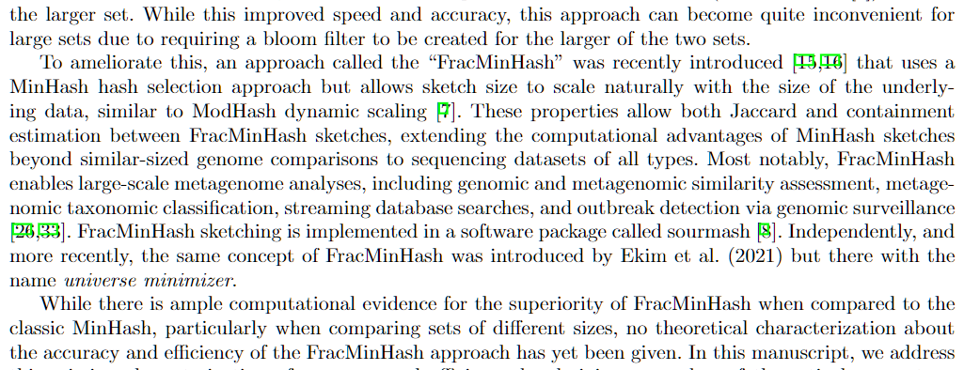
Written communication
Emphasize structural clarity
Makes it easy to understand
Transition
Thesis/topic
Support
Transition
Thesis/topic

Slide 23
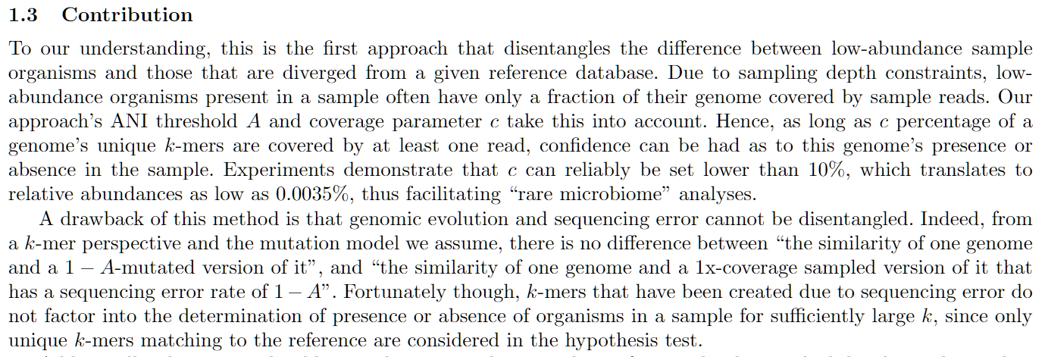
Written communication
Emphasize structural clarity
Makes it easy to understand
Transition
Thesis/topic
Support
Transition

Slide 24
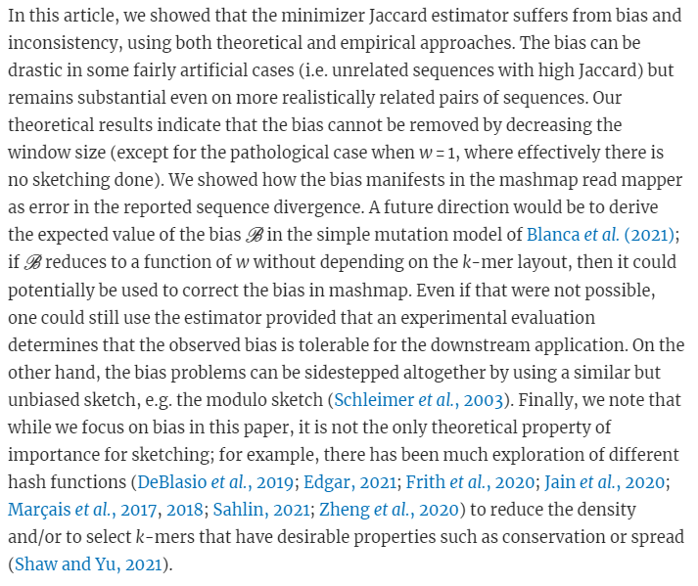
Written communication
Emphasize structural clarity
Makes it easy to understand

Slide 25
Written communication
Consider your audience
Determines level of detail and assumptions to be made
Tell a story
Captures attention
, enhances understanding
, increases memorability
Know why you are writing
Not clear to you = not clear to audience
Emphasize structural clarity
Makes it easy to understand
A figure is worth 5,000 words
Use graphic design principles
to make self-contained figures that tell a story

Slide 26
Written communication
A figure is worth 5,000 words
Use graphic design principles
to make self-contained figures that tell a story
Counter-example

Slide 27
Written communication
A figure is worth 5,000 words
Use graphic design principles
to make self-contained figures that tell a story
Counter-example
What are you trying to say?!

Slide 28
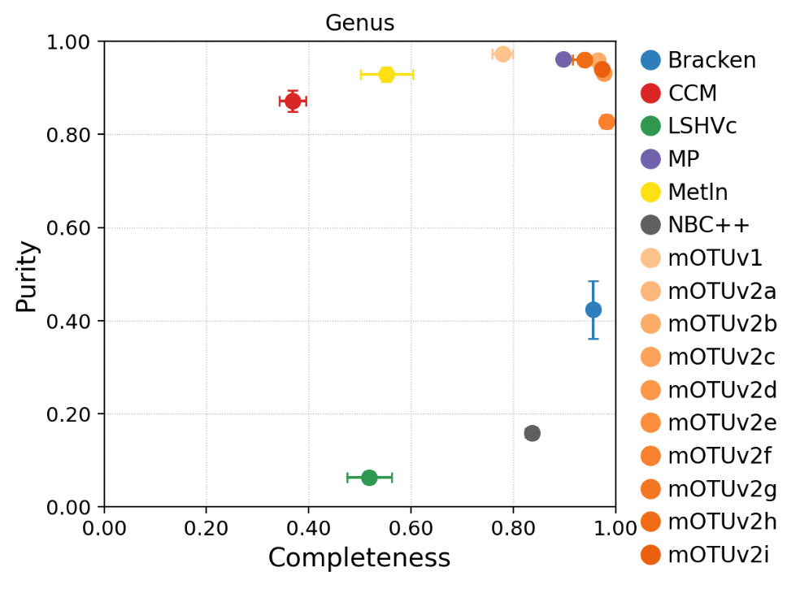
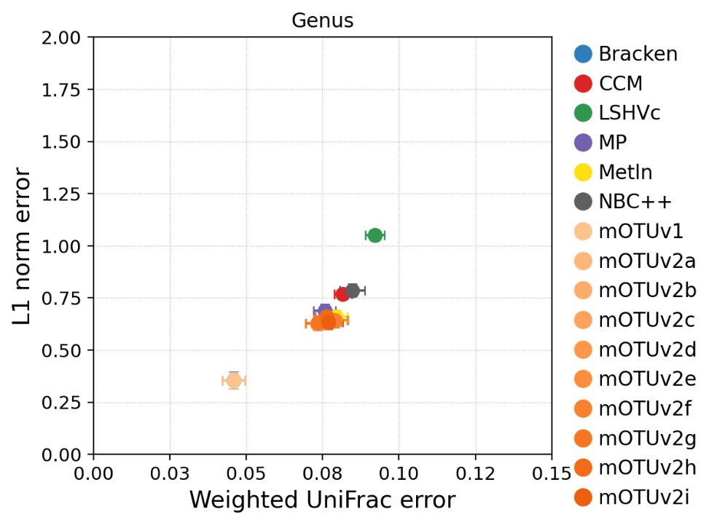
Written communication
A figure is worth 5,000 words
Use graphic design principles
to make self-contained figures that tell a story
Example
a)
b)
Fig 1. Tool performance at the genus level as quantified by a) the presence/absence metrics of purity and completeness (higher is better) and b) the relative abundance metrics of L1 norm error and Weighted UniFrac error (lower is better). Shades of the same color indicate different versions of the tool.

Slide 29
Written communication
A figure is worth 5,000 words
Use graphic design principles
to make self-contained figures that tell a story
Evolution of a figure

Slide 30
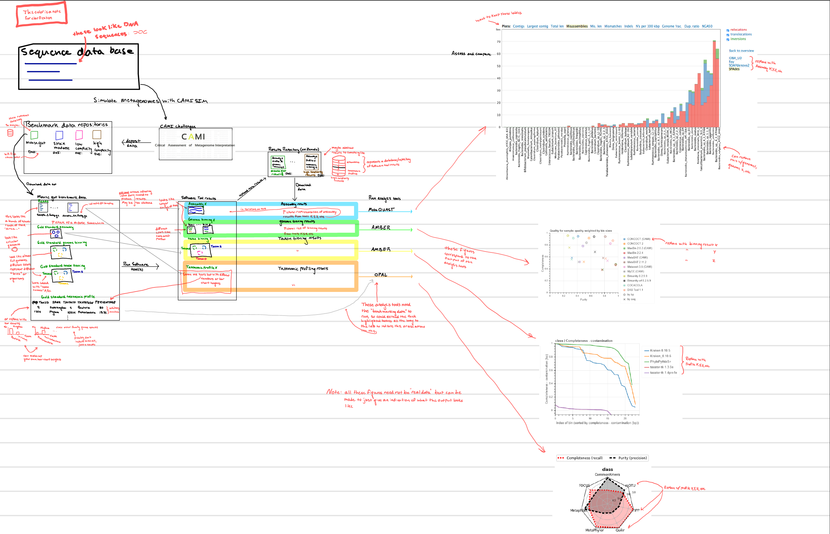
Written communication
A figure is worth 5,000 words
Use graphic design principles
to make self-contained figures that tell a story
Evolution of a figure

Slide 31
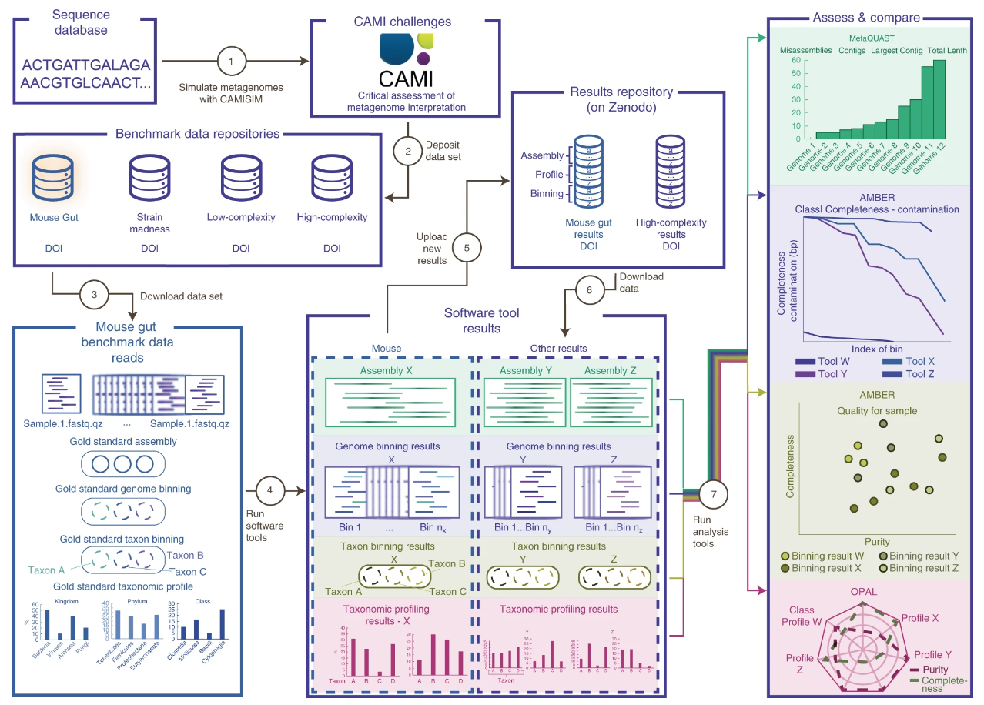
Written communication
A figure is worth 5,000 words
Use graphic design principles
to make self-contained figures that tell a story
Evolution of a figure

Slide 32
Written communication
Consider your audience
Determines level of detail and assumptions to be made
Tell a story
Captures attention
, enhances understanding
, increases memorability
Know why you are writing
Not clear to you = not clear to audience
Emphasize structural clarity
Makes it easy to understand
A figure is worth 5,000 words
Use graphic design principles
to make self-contained figures that tell a story
Emphasize brevity

Slide 33
Written communication
Emphasize brevity
Ruthlessly edit until you say what you need, and no more
Version 1:
When researchers study in vivo human pathogens, one frequently utilized approach is to isolate genetic material contained in a sample and then enrich the typically very low concentration pathogen genomic sequences in order to facilitate sequencing. While pathogen concentration is increased using this method, a majority of the sequencing data obtained still originates from host DNA as well as microbial community DNA (aka the metagenome) from microbes in and on the host. Currently, researchers then discard this non-pathogen DNA in order to focus on the pathogen associated sequences. This discarding of data means missing out on potential interesting interactions between the microbiome, the pathogen, and the host. We propose to remedy this situation by investigating how these previously discarded sequences may be utilized to study microbiome/pathogen interactions. Importantly, the aforementioned pathogen DNA enrichment process may result in biases in the resulting metagenomic data, so we propose to investigate how exactly the data is biased in the enrichment step. We will accomplish this by defining a metric that measures how non-pathogen sequences are affected in the enrichment step (a so-called “hybridization metric”). We will benchmark this metric by utilizing paired samples: samples that underwent the enrichment process before sequencing, and those that remained unenriched. With this validated metric, we will then be able to computational de-bias enriched data, thereby recovering the previously discarded sequences. This data will then allow us to investigate interesting questions such as “is microbial composition associated with pathogen outbreaks?”, “how does the microbiome influence (or is influenced by) pathogen evolution?” and “is the microbial composition associated with pathogen-induced disease progression?”. Lastly, we will provide to the broader community of pathogen researchers the resulting computational pipeline to recover and de-bias this previously discarded data.

Slide 34
Written communication
Emphasize brevity
Ruthlessly edit until you say what you need, and no more
Final version:
When researchers study human-infecting viruses using clinical samples, one frequently utilized approach is to isolate all the genetic material contained in a sample and then enrich the low-concentration virus of interest in order to facilitate sequencing. This increases the concentration of the virus, but the small size of most viruses means that most of the sequencing data still originates from the host as well as nearby non-target microbes (aka the microbial metagenome). This non-target microbial data is discarded or ignored, which means that interactions between co-occurring microbes, viruses, and the host are likewise overlooked.
We will remedy this situation by investigating how these previously discarded or “leftover” sequences may be utilized to study microbiome-virus interactions. We will first investigate whether the microbial metagenome data are biased by the target-enrichment step. This entails defining a metric to measure how non-target sequences are affected in the enrichment step (a so-called “hybridization metric”). Next, we will benchmark this metric by utilizing samples that are deep-sequenced prior to target-enrichment, as well as after enrichment.
Our goal, finally, is to computationally de-bias the “leftover” data from viral oligo-enrichment-based sequencing, thereby recovering data from the previously discarded sequences. With this, we can then investigate how the microbial metagenome mixture and abundance relates to viral outbreaks, disease progression, and/or changes in the viral population. We anticipate that this hybridization metric will have broad applicability in the community of pathogen-focused researchers, with uses far beyond those we envision here.

Slide 35
Written communication
Emphasize brevity
Ruthlessly edit until you say what you need, and no more
Final version:
When researchers study human-infecting viruses using clinical samples, one frequently utilized approach is to isolate all the genetic material contained in a sample and then enrich the low-concentration virus of interest in order to facilitate sequencing. This increases the concentration of the virus, but the small size of most viruses means that most of the sequencing data still originates from the host as well as nearby non-target microbes (aka the microbial metagenome). This non-target microbial data is discarded or ignored, which means that interactions between co-occurring microbes, viruses, and the host are likewise overlooked.
We will remedy this situation by investigating how these previously discarded or “leftover” sequences may be utilized to study microbiome-virus interactions. We will first investigate whether the microbial metagenome data are biased by the target-enrichment step. This entails defining a metric to measure how non-target sequences are affected in the enrichment step (a so-called “hybridization metric”). Next, we will benchmark this metric by utilizing samples that are deep-sequenced prior to target-enrichment, as well as after enrichment.
Our goal, finally, is to computationally de-bias the “leftover” data from viral oligo-enrichment-based sequencing, thereby recovering data from the previously discarded sequences. With this, we can then investigate how the microbial metagenome mixture and abundance relates to viral outbreaks, disease progression, and/or changes in the viral population. We anticipate that this hybridization metric will have broad applicability in the community of pathogen-focused researchers, with uses far beyond those we envision here.

Slide 36
Written communication: conclusion
Consider your audience
Determines level of detail and assumptions to be made
Tell a story
Captures attention
, enhances understanding
, increases memorability
Know why you are writing
Not clear to you = not clear to audience
Emphasize structural clarity
Makes it easy to understand
A figure is worth 5,000 words
Use graphic design principles
to make self-contained figures that tell a story
Emphasize brevity

Slide 37
Communication and Feedback
Communication
Written
Oral
Presentations
Feedback
How to receive it
How to give it

Slide 38
Communication and Feedback
Communication
Written
Oral
Presentations
Feedback
How to receive it
How to give it

Slide 39
Feedback
How to receive it
See: https://youtu.be/ivmJMpSNYEE
Dealing with feedback
Absorb
Locate
Decide
Act
Decisions to make
Add
Remove
Revise
Relocate
Reject

Slide 40
Feedback
How to give it
Constructive
Precise
Indicative

Slide 41
Application
Take a topic (past/present/future) research,
write three paragraphs in one Word document: a talk announcement for
1. a biological audience
2. a CS/math audience
3. a general audience
By 9/4, put the three paragraphs on Canvas (Discussions)
By 9/11, provide feedback on 6 paragraphs (two peers)
On 9/18, be prepared to discuss

